Slide 1
Choice dynamic data analysis
Start: November 2023

Slide 2
Steps of the code
1) Extraction of ‘’choice string’’ for both agents: BBBBRRRRBRBRBB..
I did this step by looking through Sebastisn’s codes and extraction of vectors needed for defining the choice string vector.
Imprtant: choice string vector in the code named:
A_target_color_choice_string
B_target_color_choice_string

Slide 3
Aim of the analysis
The aim is to see how ‘’action sequence’’, (when monkey is first, simult,…) affects the choice dynamic.
How do we define choice dynamic?
Looking to 5 trials before and after ‘’human transition’’ and get the average of choosing own choice.(see next slide)

Slide 4
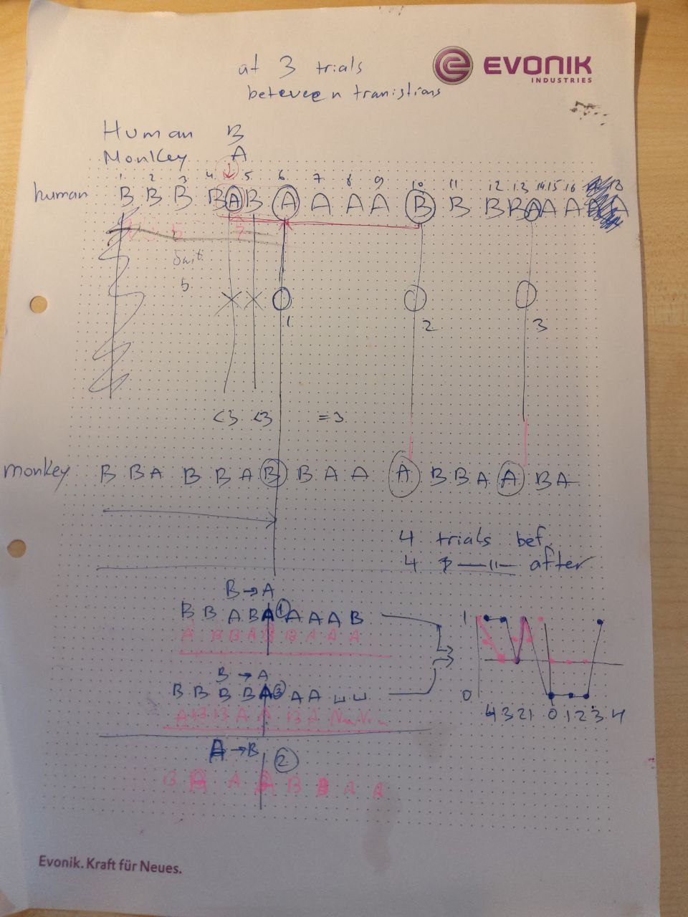

Slide 5
2) For human-monkey sessions. ‘’Transition points’’ are defined only from human side. Because human explicitly knows when to switch from his own choice to other choice and it is nonsense to evaluate human behavior from monkey’s switches.
But for monkey-monkey data analysis we should have a code that is adaptable about side of the transition point. It can be Curius or Elmo side.
3) How do we filter out ‘’choice string’’ vector for action sequence?
Applying time filter on choice string could be:

Slide 6
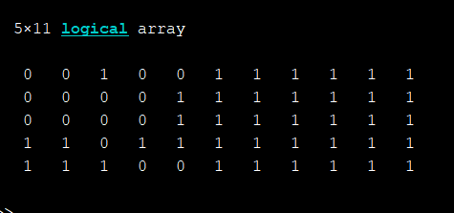
Sebastian approach, pink curve: apply timing filter(action sequence) on
human transition trials , only on those trials and not else. This approach appears as pink curves in plots (all trials)
In this session, there are 5 human RB switching when monkey was first, trials inside the red oval all belong to trials that human transitted AND monkey was first. Other trials don’t care about the moneky’s turn time.

Slide 7
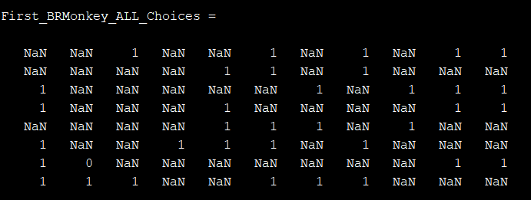
Igor's approach, red curve in plots: timing (action sequence) is applied not on human transition point but on the whole trials, unrelated trials will be replaced as NaN (only proper timing trials)
In this session, in total there are 8 RB human switches, all trial when monkey is first are indicated as 1 and other than first, with NaN

Slide 8
4)For blocked sessions we withdraw too close switches (look at the variable ThresholdForValidSwitch) but for shuffled it is not possible because there too many switches.

Slide 9
Monkey- Monkey analysis
1) Because never the monkey complies software’s instructions for shuffled or blocked, all labels are ‘NONE’.
2) at the end we need to apply action sequence filter (first, simul, second) at the results of two matrices embedded in next slide

Slide 10
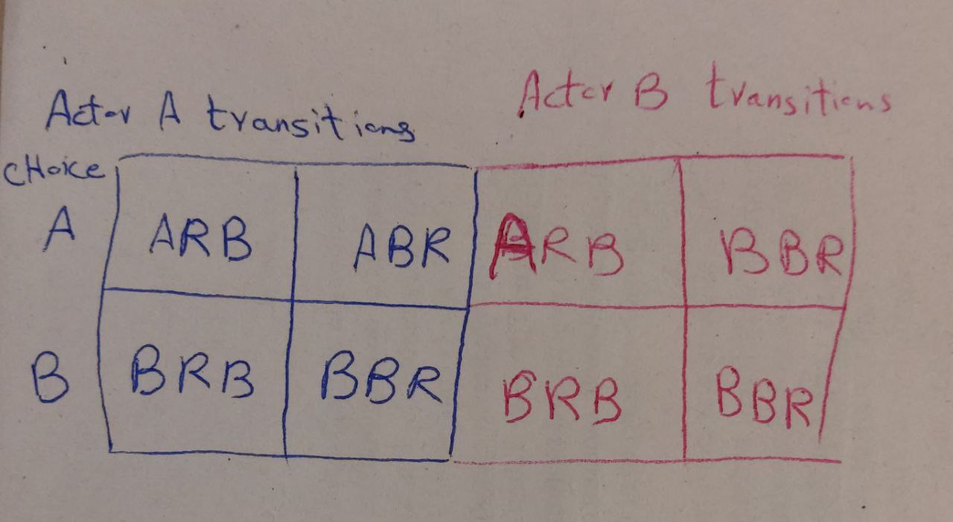

Slide 11
Legends of the plots
Red: choice string belongs to actor A, all trials given color transition, aggregate only trials in which timing condition was true (proper timing)
Pink: choice string belongs to actor A, select trials in which color transition happens with specific timing aggregate all trials before and after for the switch (all trials)
Blue: choice string belongs to actor B, timing filter from Igor’s approach, all trials given color transition, aggregate only trials in which timing condition was true (proper timing)
Cyan: choice string belongs to actor B, select trials in which color transition happens with specific timing aggregate all trials before and after for the switch (all trials)

Slide 12
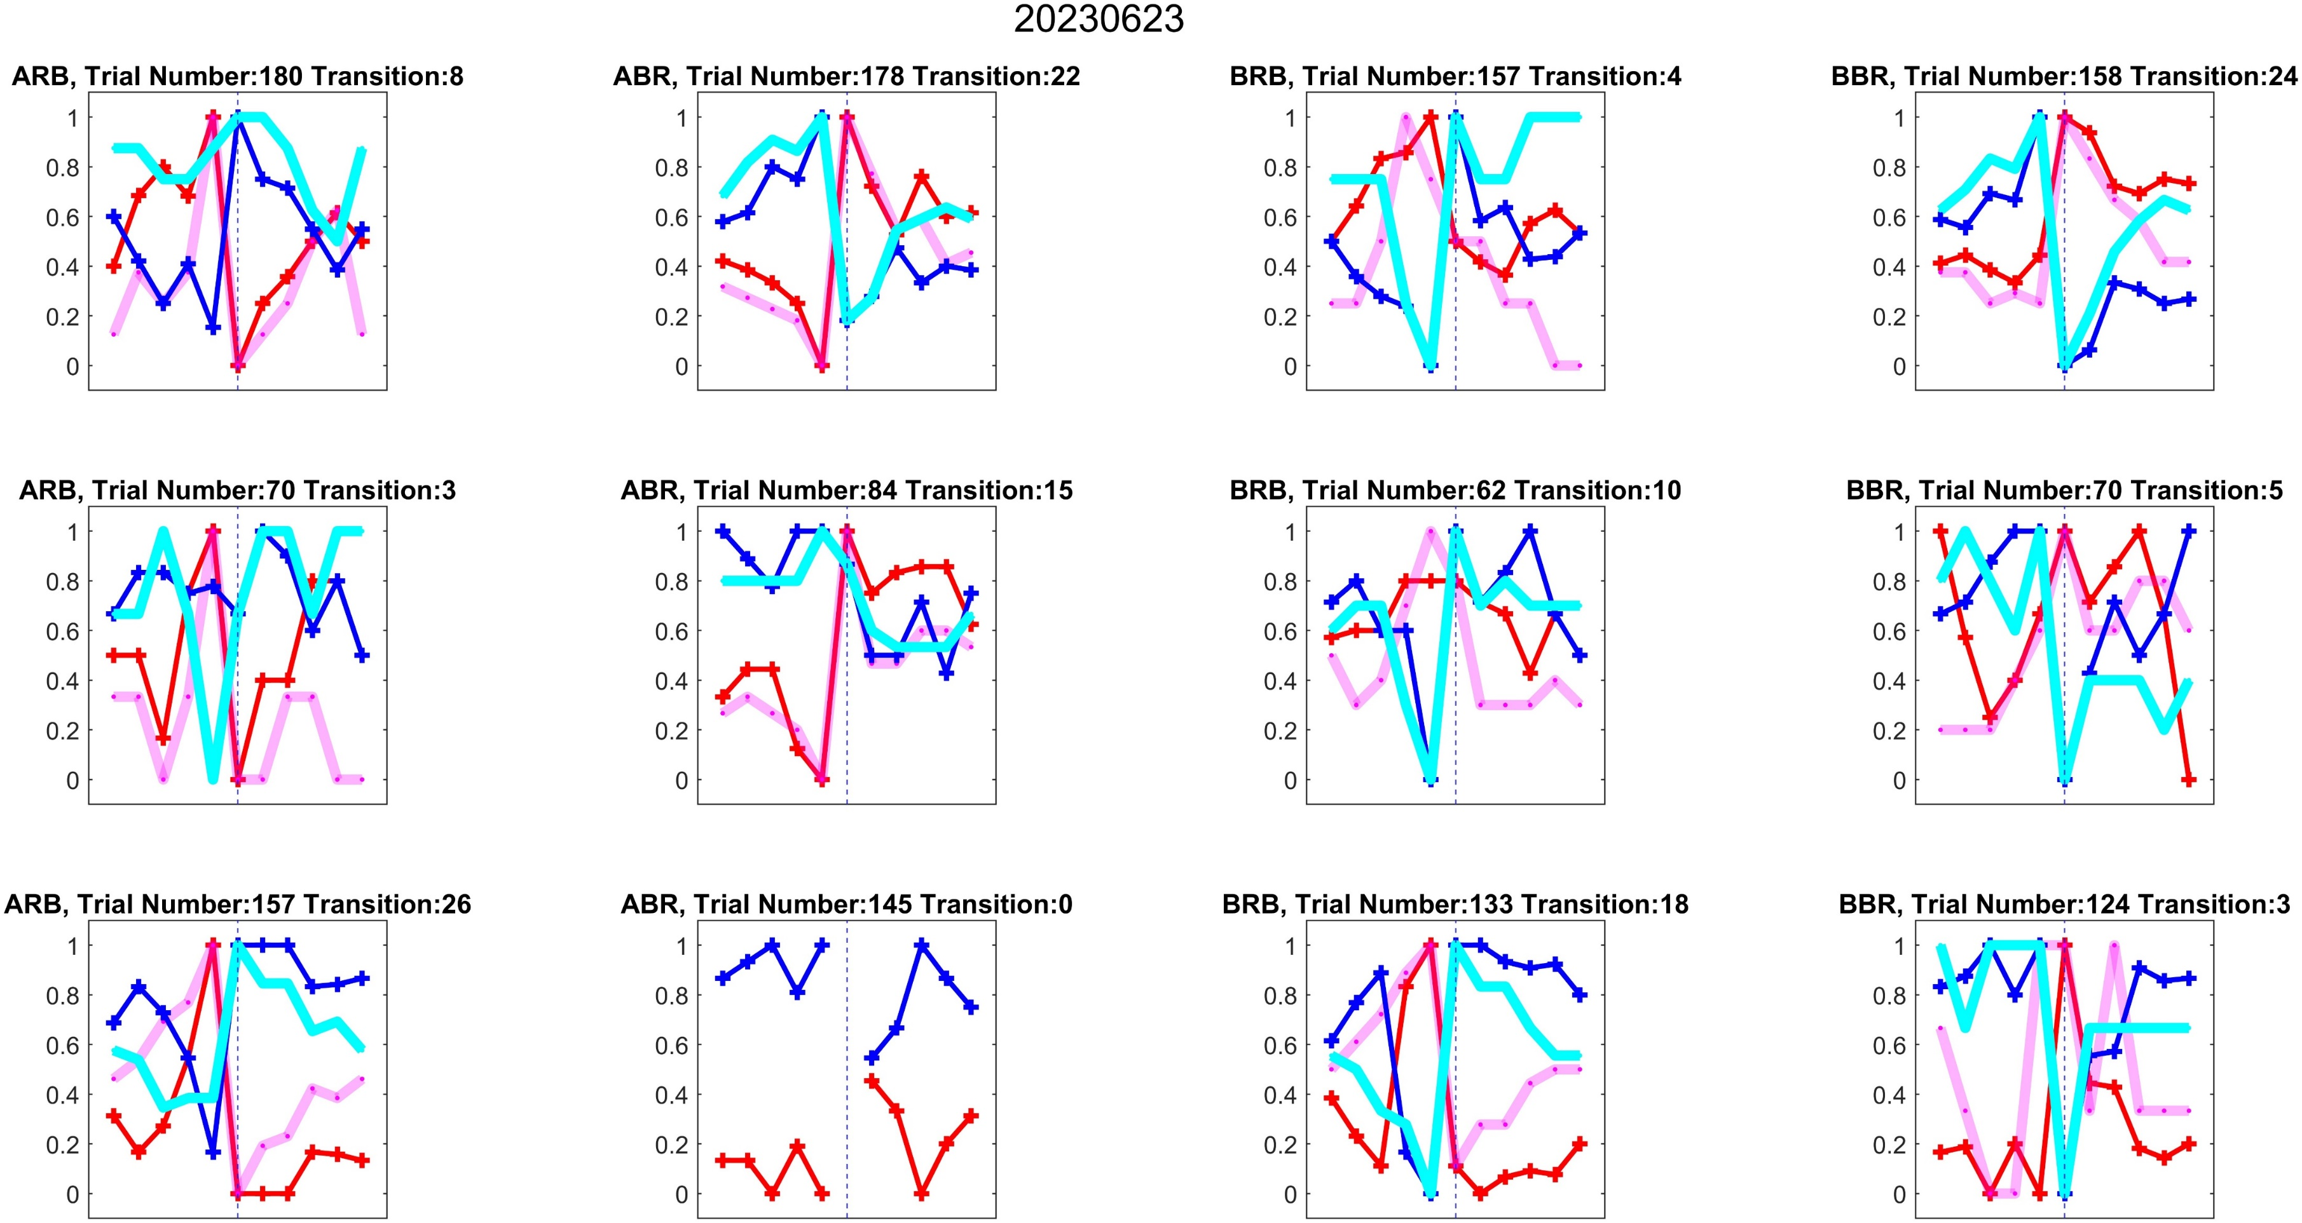
One example result
All trials
A first
Proper timing (B is second)
A second

Slide 13
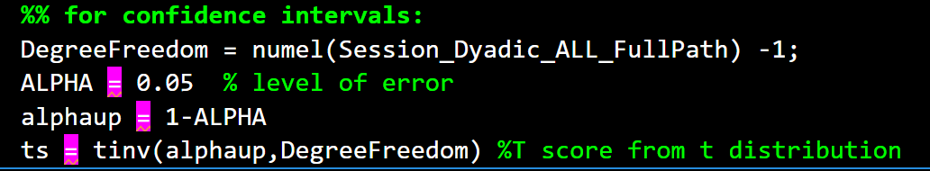
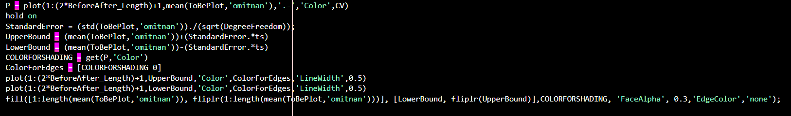
Between session analysis
As like all analysis we should 0.95 confidence intervals from t distribution:

Slide 14
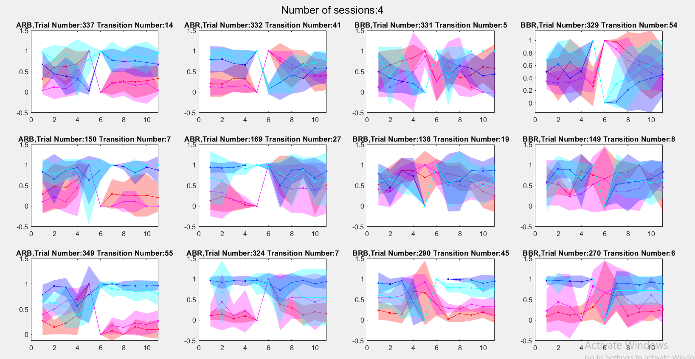
Since we only have 4 sessions of monkey monkey dyadic, CIs are so wide and noisy. I show the plots without CI till having more data for that

Slide 15
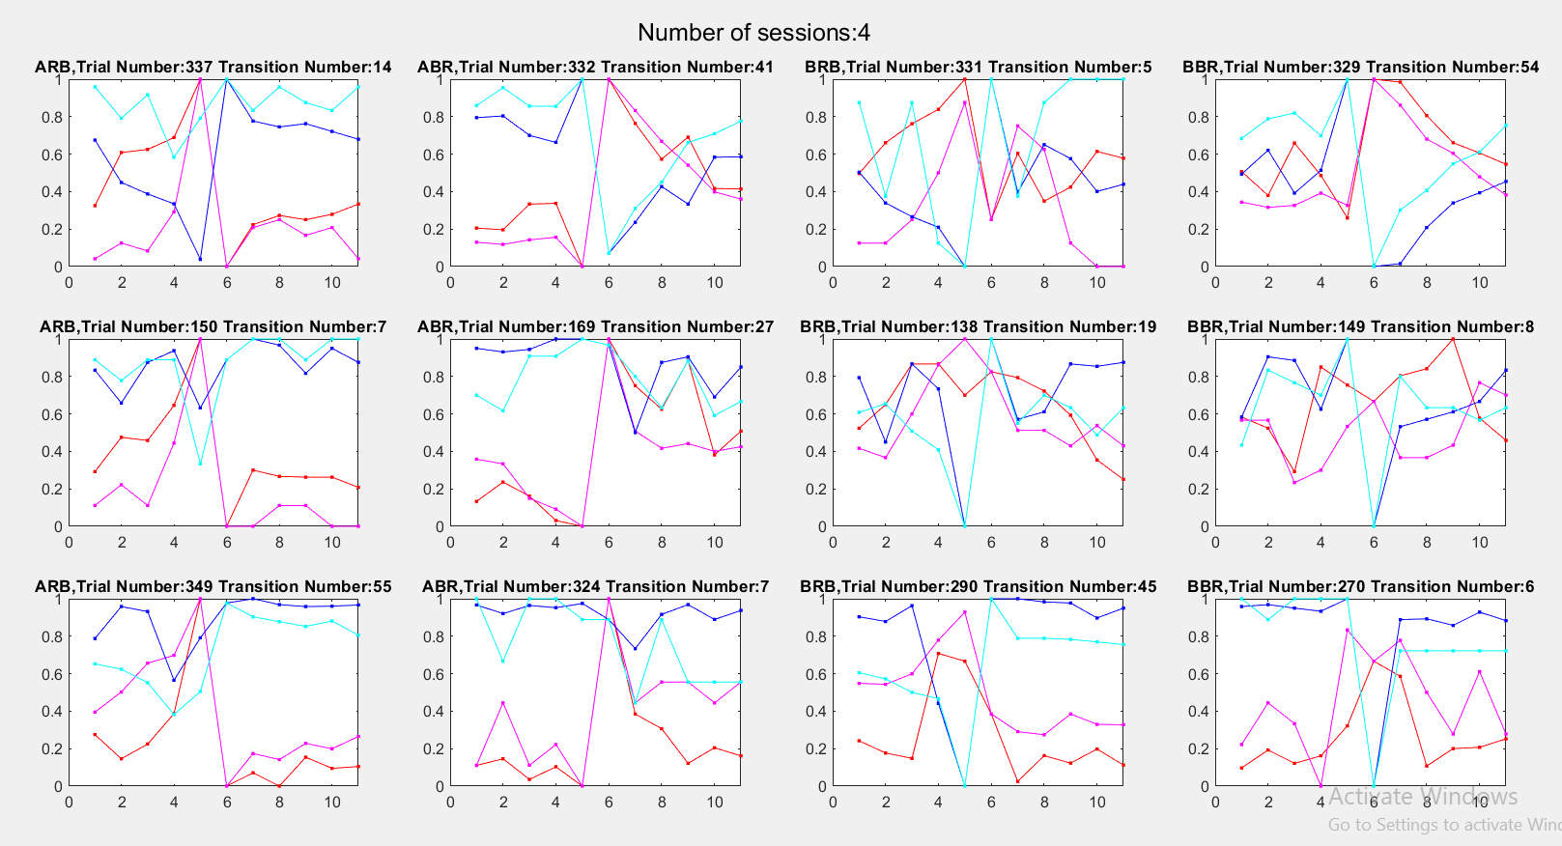
Proper timing (B is second)
Proper timing
(A is first)
A first
B second
All trials
All trials
Proper timing (B is first)
B first
A second

Slide 16
Observational interpretations
When 2nd monkey had information about other’s switch, how 2nd monkey changes choice dynamic?
Why switch happen? :
Roots of switches are: 1) side biases 2) random 3) following other
Rare deviations from coordination or selfish selection – are those driven by specific history of preceding choices?
- Alternatives: random or side bias?

